Slide 1

Cardiac Risk Analysis
A Comprehensive Analysis of Heart Disease Incidence
Presented by:
Kaneez Masooma
kaneezmasoomaofficial@gmail.com

Slide 2

Introduction
Objective: To conduct an in-depth analysis of heart disease data using Python to identify key risk factors and patterns.
Key Goals:
Identifying Patients at Risk:
Analyze patient data to determine who is most at risk of developing heart disease, focusing on critical indicators such as age, sex, and medical history.
Understanding Influential Factors:
Uncover and understand the significant factors that influence heart disease, such as lifestyle choices, medical conditions, and demographic attributes.
Enhancing Predictive Models:
Utilize data analysis and machine learning techniques to improve the accuracy of heart disease prediction models, contributing to better diagnosis and prevention strategies.

Slide 3


Data Introduction
Total Records: 1025 patient records with 14 attributes.
Attributes:
Age: Patient's age in years.
Sex: Gender of the patient (1 = Male, 0 = Female).
Chest Pain Type: Type of chest pain experienced (4 categories).
Resting Blood Pressure: Blood pressure in mm Hg on admission to the hospital.
Cholesterol: Serum cholesterol in mg/dl.
Fasting Blood Sugar: Blood sugar level (> 120 mg/dl).
Resting ECG: Results of the resting electrocardiogram (3 categories).
Max Heart Rate: Maximum heart rate achieved.
Exercise-Induced Angina: Whether angina occurred during exercise.
Oldpeak: ST depression induced by exercise relative to rest.
Slope: The slope of the peak exercise ST segment.
Number of Major Vessels: Number of major vessels colored by fluoroscopy (0-3).
Thalassemia: Blood disorder indicator (3 categories).
Target: Indicates whether the patient has heart disease (1 = Disease, 0 = No Disease).

Slide 4


Data Preprocessing
Duplicates Removal:
Identified and removed 723 duplicate entries, resulting in a refined dataset of 303 unique rows.
Missing Values:
Missing values were identified and effectively treated using statistical methods, such as mode imputation, ensuring data integrity.
Outliers:
Outliers were detected using boxplots, particularly affecting attributes like cholesterol and blood pressure and old peak.
Post-cleaning, the dataset consisted of 283 rows and 14 columns, providing a robust foundation for analysis.
Key Considerations:
The dataset represents a balanced distribution of patients with and without heart disease.
Data cleaning and preprocessing were critical to ensure the reliability of the analysis.

Slide 5






Key Metrics Overview
198
283
85
90(45% of total males)
158
(56%)
68(80% of total females)

Slide 6
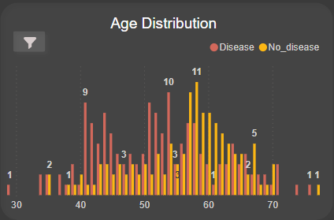
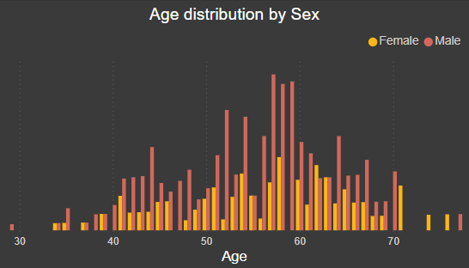
Age Distribution
The dataset covers an age range of 29 to 77 years.
The age group with the highest incidence of heart disease is between 40 and 58 years.
From age 57 onwards, the number of individuals without heart disease increases.
Average age of Male and Female is 55 and 54 years respectively.
Insights:
There is a negative correlation between age and disease incidence, with a correlation coefficient of -0.2, indicating that as age increases, the likelihood of heart disease slightly decreases in this dataset.

Slide 7
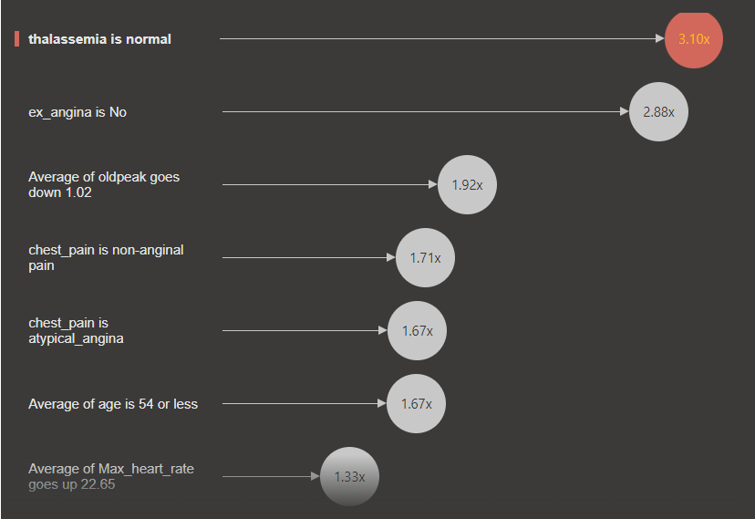
Key Influencers
Thalassemia
Exercise Induced Angina
Old Peak
Chest Pain
Age
Maximum Heart Rate

Slide 8
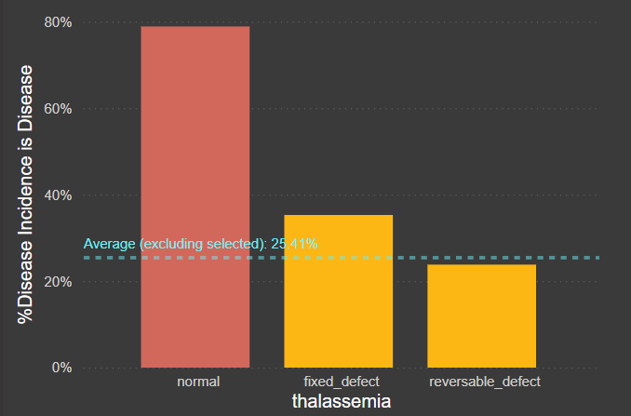
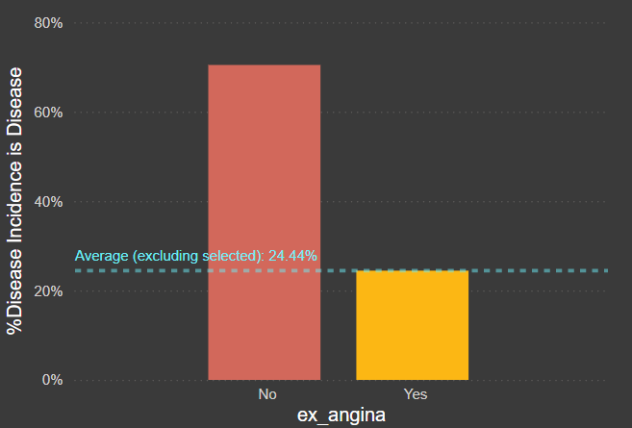
Thalassemia & Exercise-Induced Angina: Impact
Thalassemia: Increases the likelihood of disease incidence by 3.10x when normal.
Exercise-Induced Angina (ex_angina): Increases the likelihood by 2.88x when not present.

Slide 9
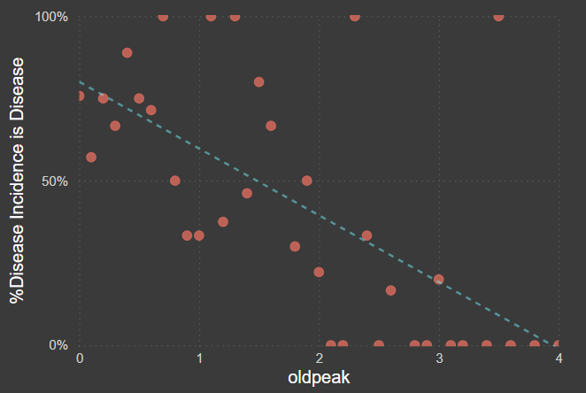
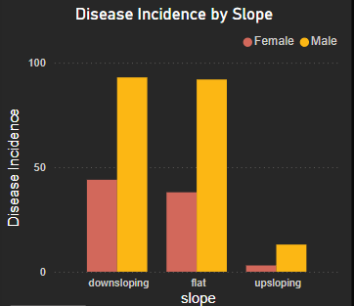
Old Peak & Slope: Impact
Old Peak Levels: Higher values decrease the risk, as shown by a 1.92x decrease when levels drop by 1.02 units.
Slope: Downsloping may be a prominent factor causing cardiac risk among men and women.

Slide 10
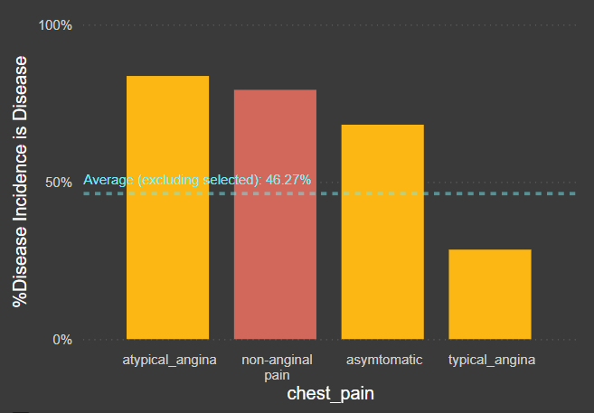
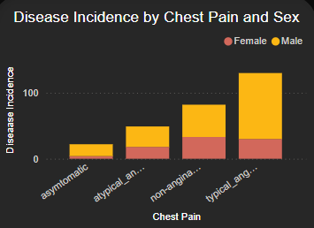
Chest Pain Type: Disease Risk
Chest Pain Type:
When chest pain atypical_angina, disease incidence increases by 1.67 times.
When chest pain non-anginal, disease incidence increases by 1.71 times.
Chest Pain vs. Sex:
In females, non-angina pain is often more prominent, while males typically experience classic angina more frequently.

Slide 11
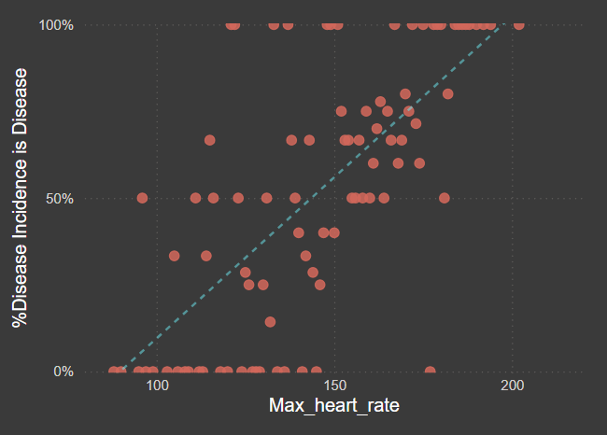
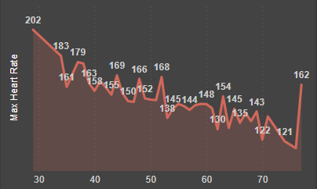
Maximum Heart Rate
Effect on Disease Incidence: When the average maximum heart rate increases by 22.65, the likelihood of heart disease incidence increases by 1.33 times.
Maximum Heart Rate vs Age: In younger age groups, the Max Heart Rate is higher.
Insights: As age increases, there is often a gradual decline in Max Heart Rate, which may contribute to the lower incidence of heart disease observed in older patients.
Age

Slide 12
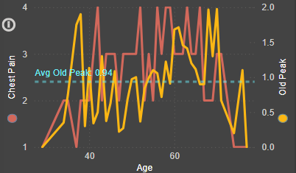
Chest Pain & Old Peak by Age
Chest Pain vs. Age: The frequency and type of chest pain (angina) can vary with age.
Observation: The graph shows a higher incidence of chest pain in middle-aged individuals, particularly between 40-58 years. This could suggest that chest pain as a symptom is more pronounced in this age group, potentially indicating a higher risk of heart disease.
Old Peak vs. Age: "Old Peak" refers to the ST depression induced by exercise relative to rest, which can indicate the severity of heart disease.
Observation: Older patients often exhibit higher Old Peak values, suggesting a reduced likelihood of heart disease with increasing age. This trend aligns with the observed distribution of disease incidence by age, indicating that as age advances, the risk of heart disease decreases, as evidenced by elevated Old Peak levels.

Slide 13
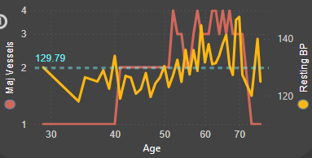
Blood Pressure & Major Vessels by Age
Resting Blood Pressure vs. Age: Resting Blood Pressure generally increases with age due to the stiffening of blood vessels and the increased resistance in the arterial system.
Observation: The graph may display a positive correlation between age and Resting Blood Pressure, with older individuals tending to have higher average blood pressure. This trend highlights the importance of monitoring blood pressure as a critical factor in managing heart disease risk, particularly in older populations.
No. of Major Vessels vs. Age: There is a noticeable trend that as age increases, the number of major vessels with significant narrowing tends to rise.

Slide 14

Conclusion
Thalassemia: Increases disease incidence by 3.10x when normal.
Exercise-Induced Angina: Increases disease incidence by 2.88x when not present.
Old Peak Levels: Higher values decrease risk, with a 1.92x reduction when levels drop by 1.02 units.
Chest Pain Types: Atypical angina increases disease incidence by 1.67x.Non-anginal pain increases disease incidence by 1.71x.
Chest Pain vs. Sex:
In females, non-anginal pain, lower resting blood pressure (≤122), and downsloping patterns are more prominent.
In males, classic angina, lower old peak, ST-T abnormalities in resting ECG, and higher maximum heart rate are more frequent.
Effect of Maximum Heart Rate: A 22.65 increase in maximum heart rate raises heart disease incidence by 1.33x.
Maximum Heart Rate vs. Age: Younger individuals have higher maximum heart rates, with a decline in older patients contributing to lower heart disease incidence.

Slide 15

Recommendations
Resting Blood Pressure vs. Age: Resting Blood Pressure generally increases with age due to the natural stiffening of blood vessels and heightened arterial resistance. This positive correlation indicates that older individuals often have higher average blood pressure, underscoring the need for vigilant blood pressure monitoring to manage heart disease risk, particularly in older populations.
Number of Major Vessels with Significant Narrowing vs. Age: As age increases, the number of major vessels with significant narrowing tends to rise. This trend suggests that older individuals are more likely to have a greater number of affected vessels, which is associated with a higher risk of cardiovascular conditions. Age, therefore, plays a crucial role in the progression and severity of heart disease.
Maximum Heart Rate vs. Age: Younger age groups typically have higher Maximum Heart Rates. As individuals age, there is a gradual decline in Maximum Heart Rate, which may contribute to the lower incidence of heart disease observed in older patients. This decline in Maximum Heart Rate with age highlights the potential impact of aging on cardiovascular function and endurance.

Slide 16
Thank You!
Icons by Freepik/kalashnyk from www.flaticon.com

